Slide 1
WarFront
Matt Newbill
Matt Hamersky
Max Sadovskiy

Slide 2
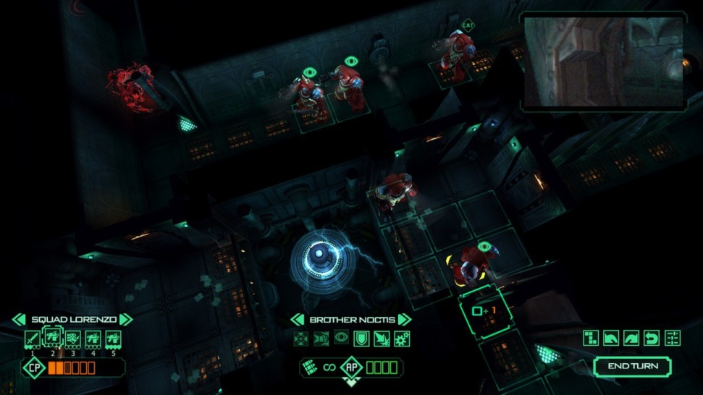
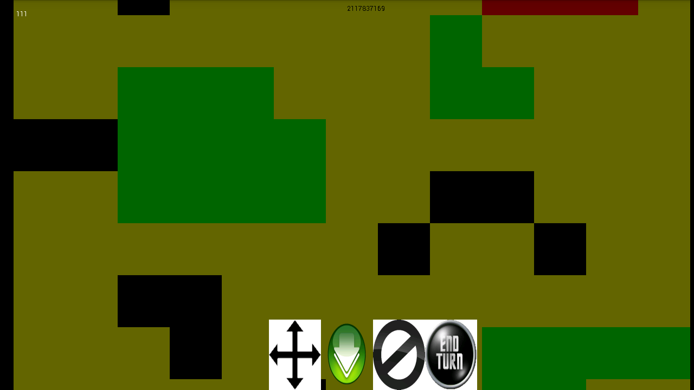
Application Vision and Idea
Strategic turn based mobile unit combat game

Slide 3
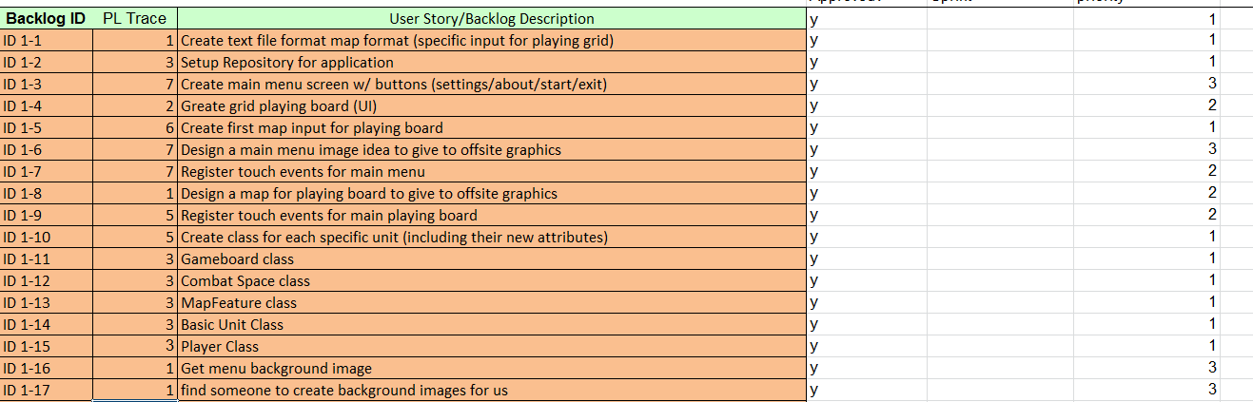
Project Backlog (Summary)
Render main menu screen and map
Design and implement player objects and sub objects
Implement player’s set units phase
Implement player’s unit movement and vision
Implement player’s unit attack
Implement winning game features
Implement player’s base object

Slide 4
SCRUM Methodology
Sprints
2 weeks long
Meetings
Sprint Planning Meetings/Sprint Review (at beginning/end of each sprint)
Product Backlog
Burndown Chart
Daily Scrum Meetings
Code review
Architecture discussion

Slide 5
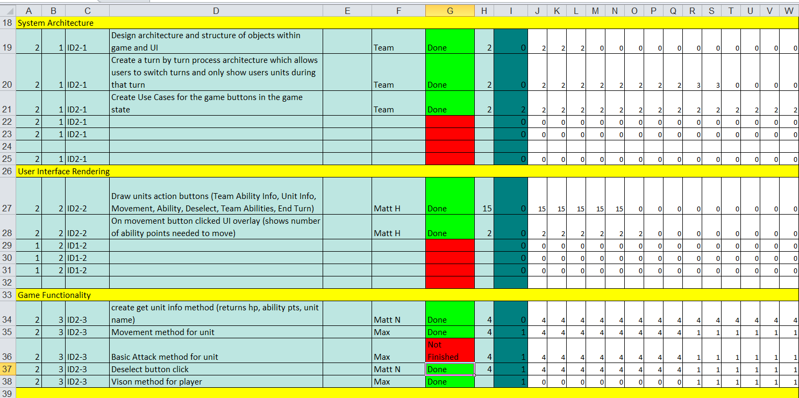
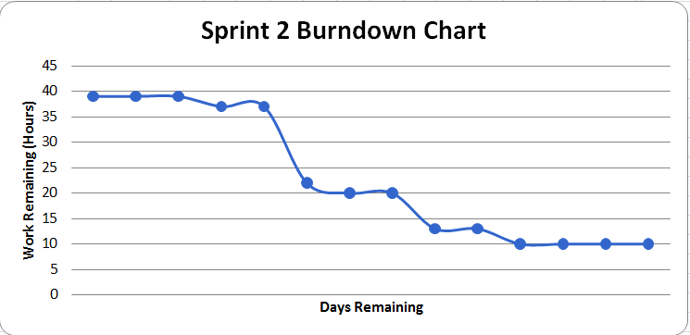
Sprint Backlog and Burndown Chart

Slide 6
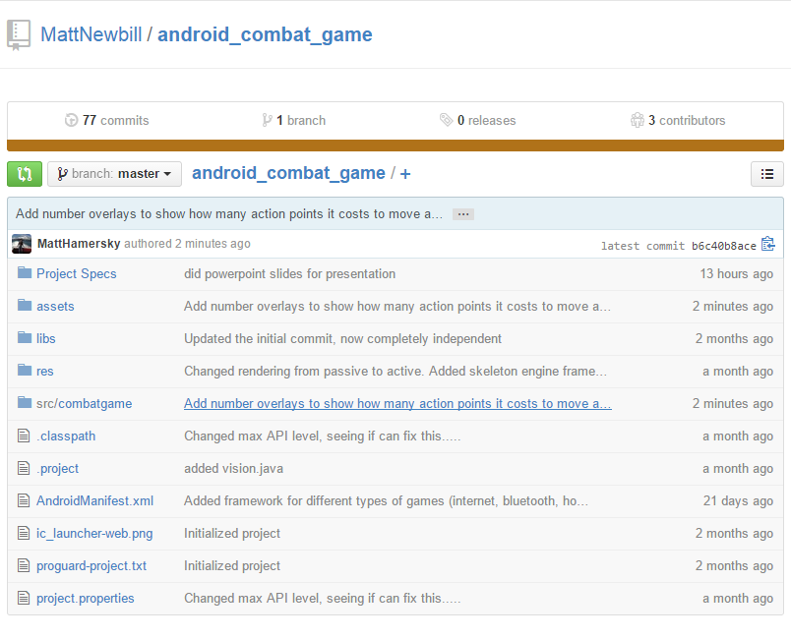
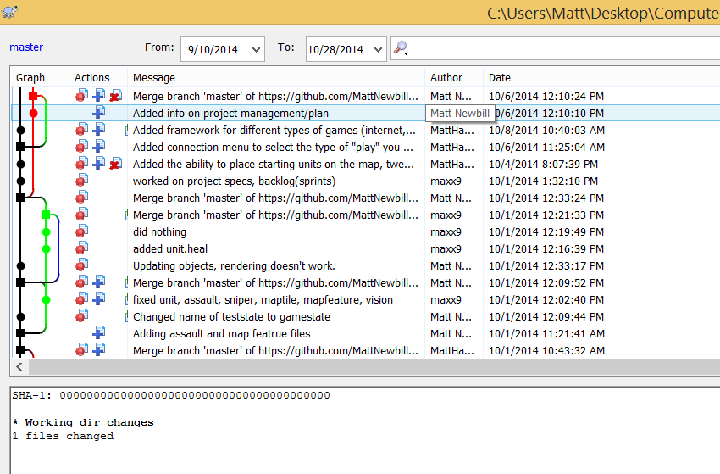
Project Asset Library and Source Version Control
https://github.com/MattNewbill/android_advising_system

Slide 7
Challenges and risks
Performance
Garbage Collector -> Unresponsive UI
Animations -> Memory Allocation Restraints
Commercial
Requires user base to launch
Competitive market with other games
Challenges
Project management tools -> Jiro
IDE (Eclipse)
Accommodating different screen sizes

Slide 8
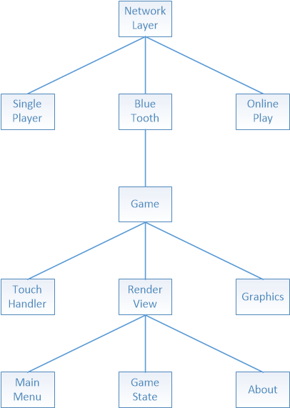
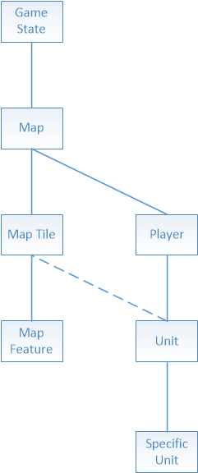
Application Architecture

Slide 9
Engine
Passive to Active rendering
SurfaceView
Custom Widgets
Object Creation
Pooling
FSM

Slide 10
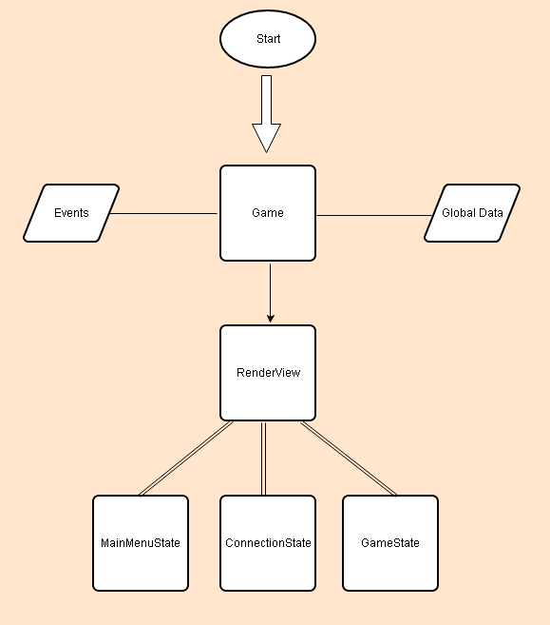

Slide 11
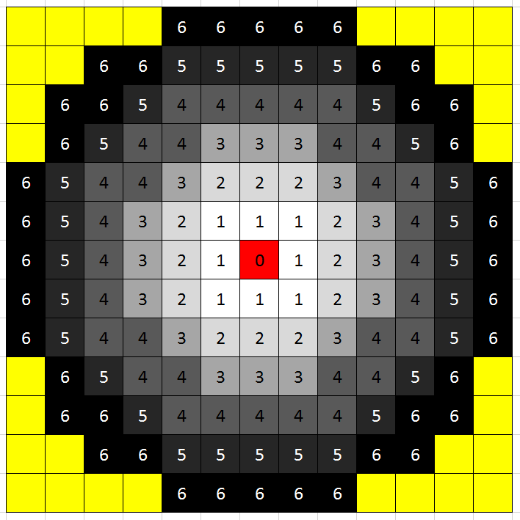

Slide 12
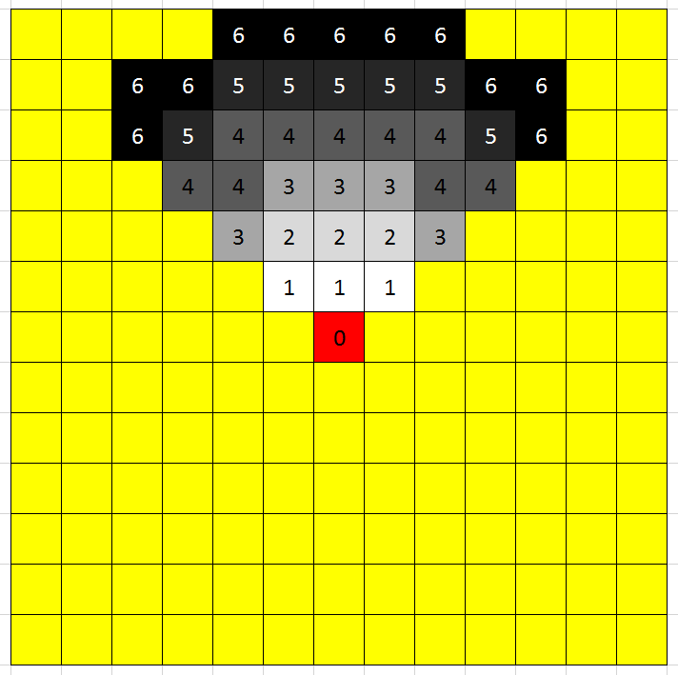

Slide 13
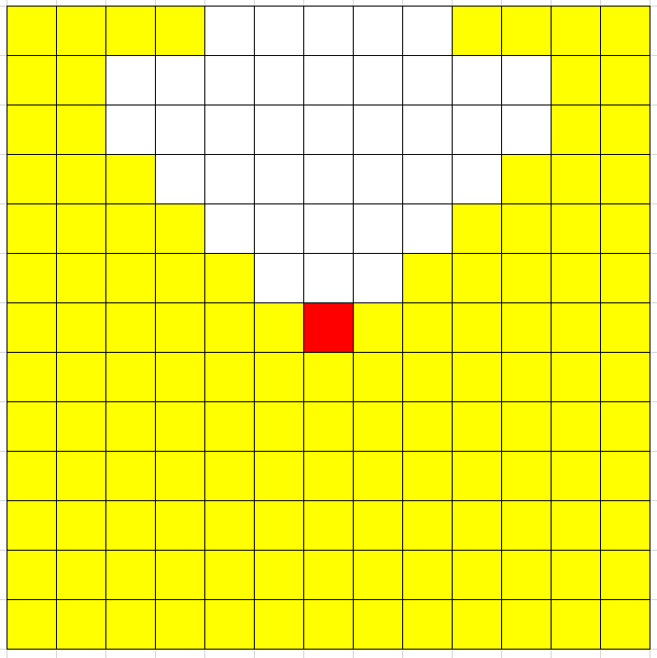

Slide 14


Slide 15
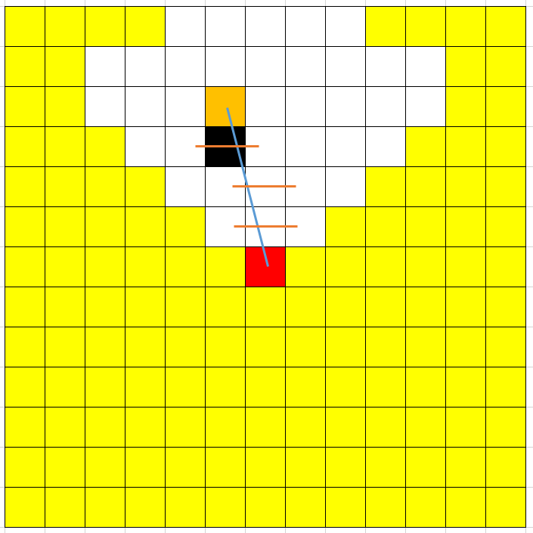

Slide 16
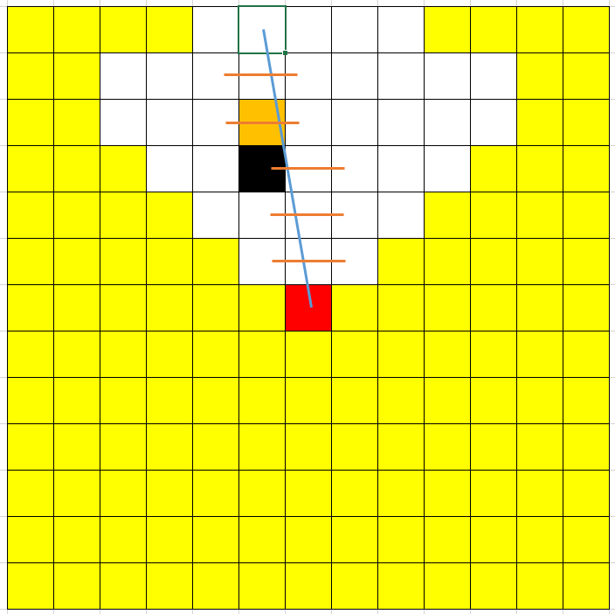

Slide 17
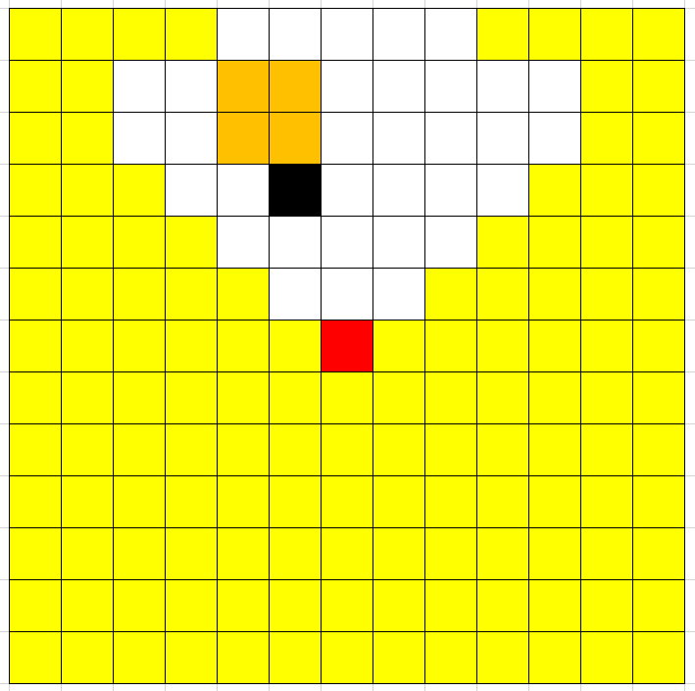

Slide 18
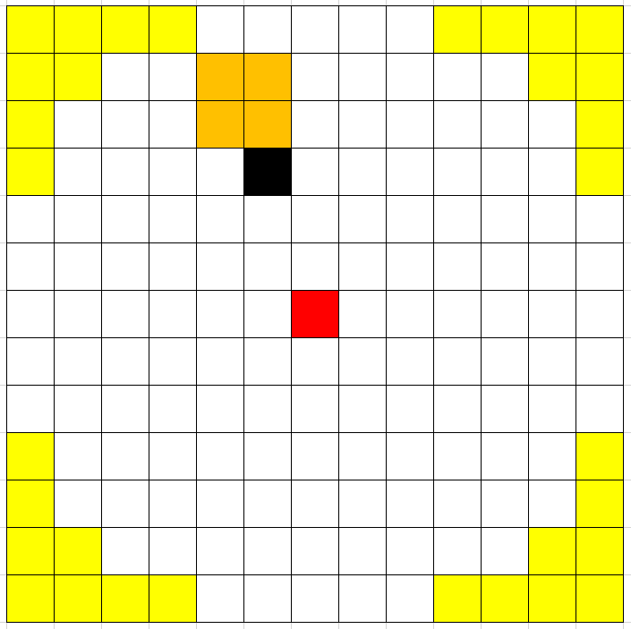

Slide 19
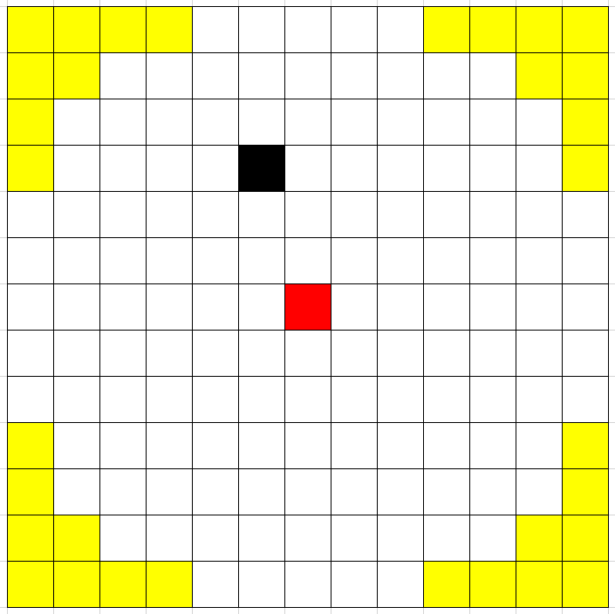

Slide 20
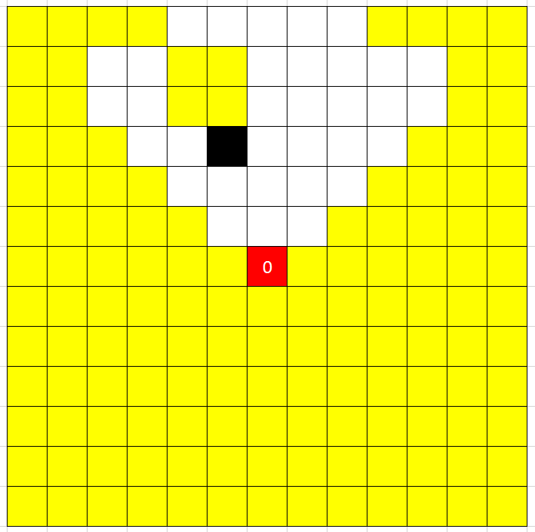

Slide 21
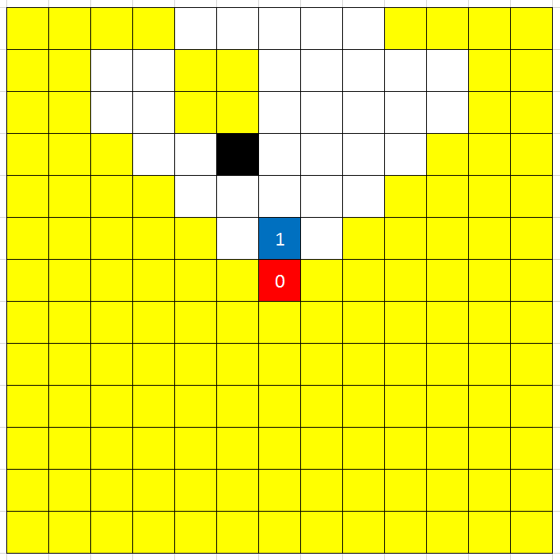

Slide 22
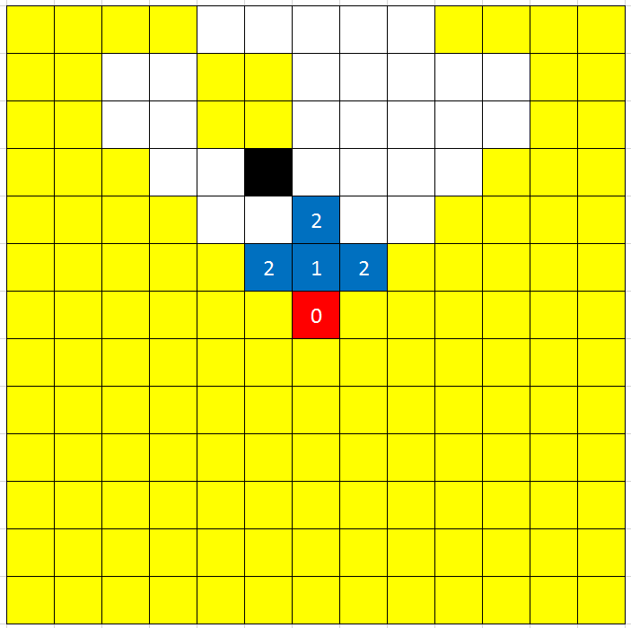

Slide 23
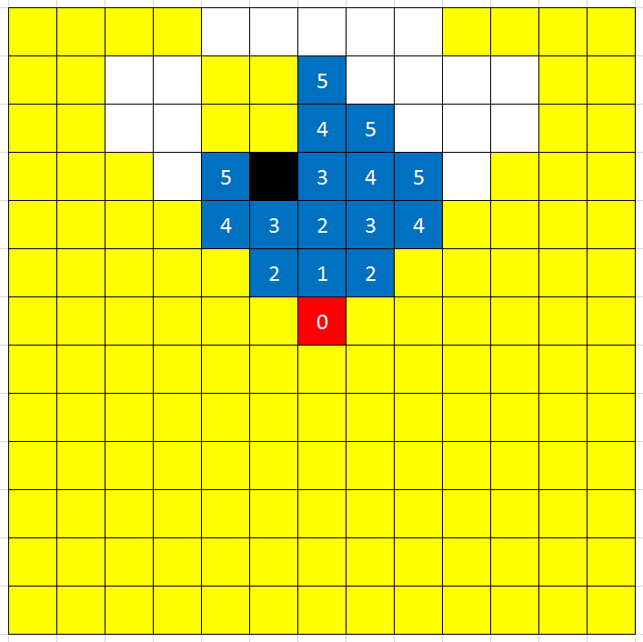

Slide 24
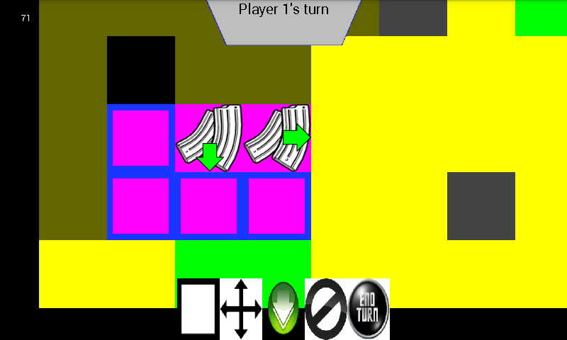

Slide 25
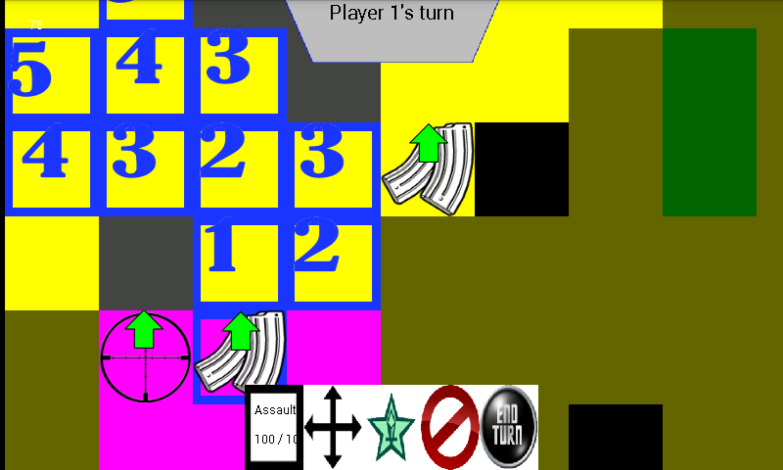

Slide 26
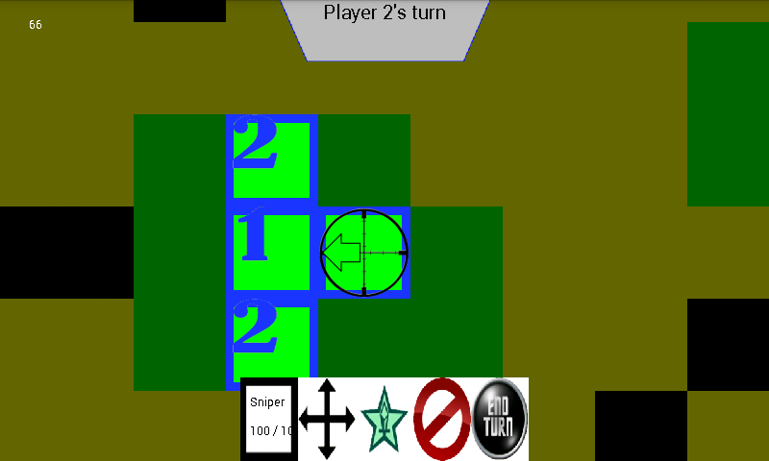

Slide 27
